Slide 1

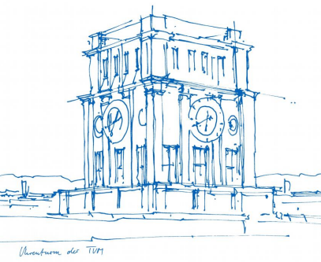
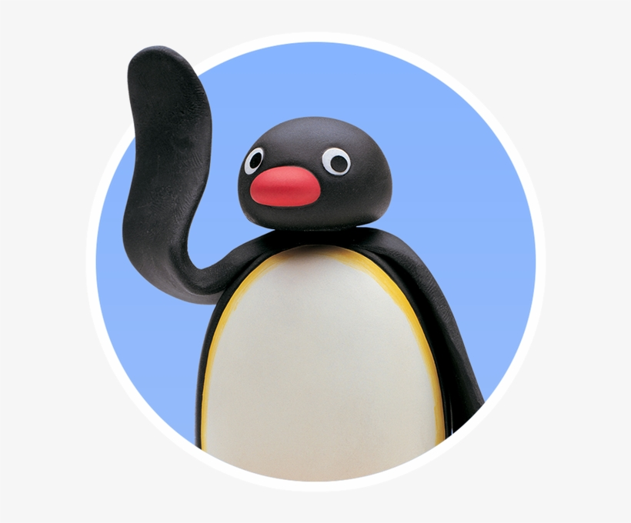
Interaction Prototyping
Lehrstuhl für Ergonomie TUM School of Engineering and Design Technical University of Munich
Milestone 1
The Rolling Penguins
Vincent Brunner Beatrice Seibert Stefano Ferrari
Winter Semester 2021/2022

Slide 2
Lehrstuhl für Ergonomie TUM School of Engineering and Design Technical University of Munich
Content
Design Challenge
Interviews
Personas & Scenarios
Use Flow & App Functionality
Paper Prototype
User Test Guideline
Usability Report
Benchmarking
Vincent Brunner | Beatrice Seibert | Stefano Ferrari| Interaction Prototyping| Winter Semester 2021/2022
1

Slide 3
Lehrstuhl für Ergonomie TUM School of Engineering and Design Technical University of Munich
Design Challenge - EventFinder
What is an event?
EventFinder:
1."A planned occasion or activity (such as a social gathering)“
2."An occurrence regarded as a bare instant of space-time as contrasted with an object which fills space and has endurance"
Find present and future events based on the interests of the user. Allow users to organize public events, which can be then published and featured in the page.
Defining the challenge by knowing:
- Who has the problem? - What is the problem? - In what environment will the design be used? - What is the desired outcome/effect? - What side effects need to be avoided?
https://www.merriam-webster.com/dictionary/event https://www.collinsdictionary.com/dictionary/english/event
Vincent Brunner | Beatrice Seibert | Stefano Ferrari| Interaction Prototyping| Winter Semester 2021/2022
1

Slide 4
Lehrstuhl für Ergonomie TUM School of Engineering and Design Technical University of Munich
Qualitative Research - Interviews
Why Interviews?
Our approach
Very beginning of development process: quick and easy
Get to know target user group: demography, personality, behaviour
Understand the user environment when using similar apps
Learn about our competitors
Semi-structured interview
Research guidelines with structure: Introduction – questions – wrap up
Remotely with 5 users meeting our target group
}
Personas and Scenarios
Vincent Brunner | Beatrice Seibert | Stefano Ferrari| Interaction Prototyping| Winter Semester 2021/2022
1

Slide 5
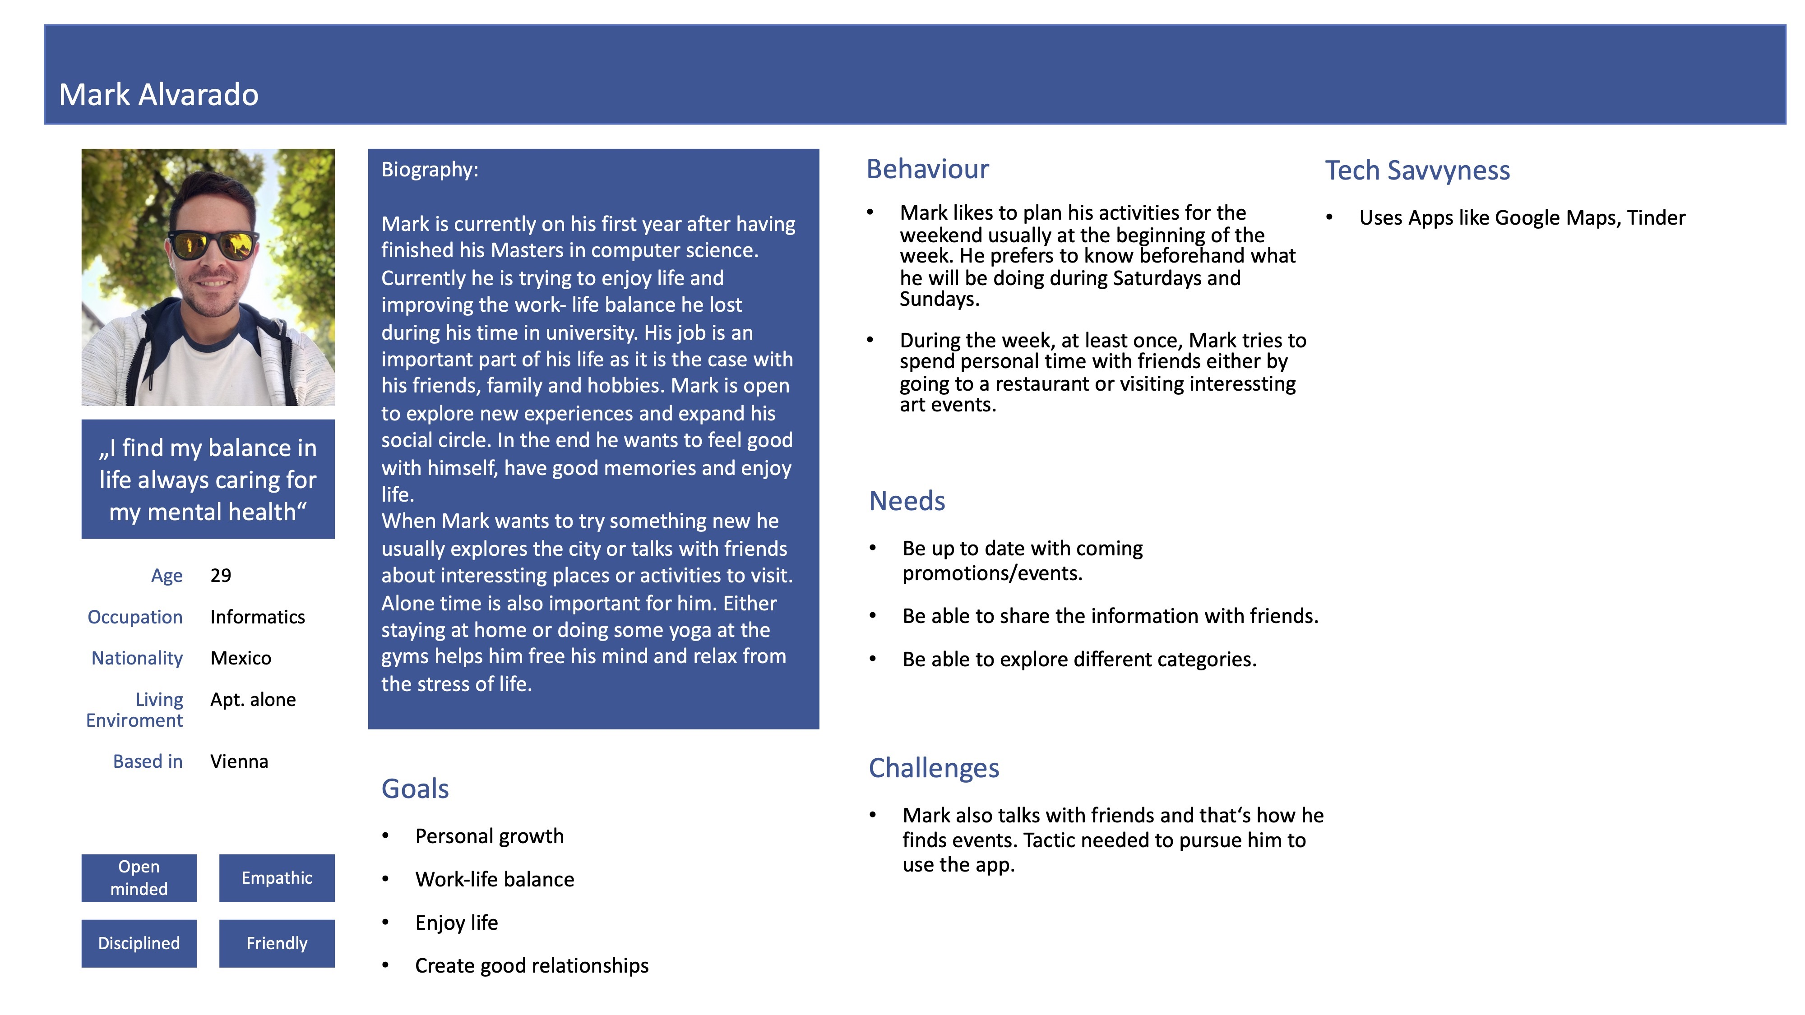
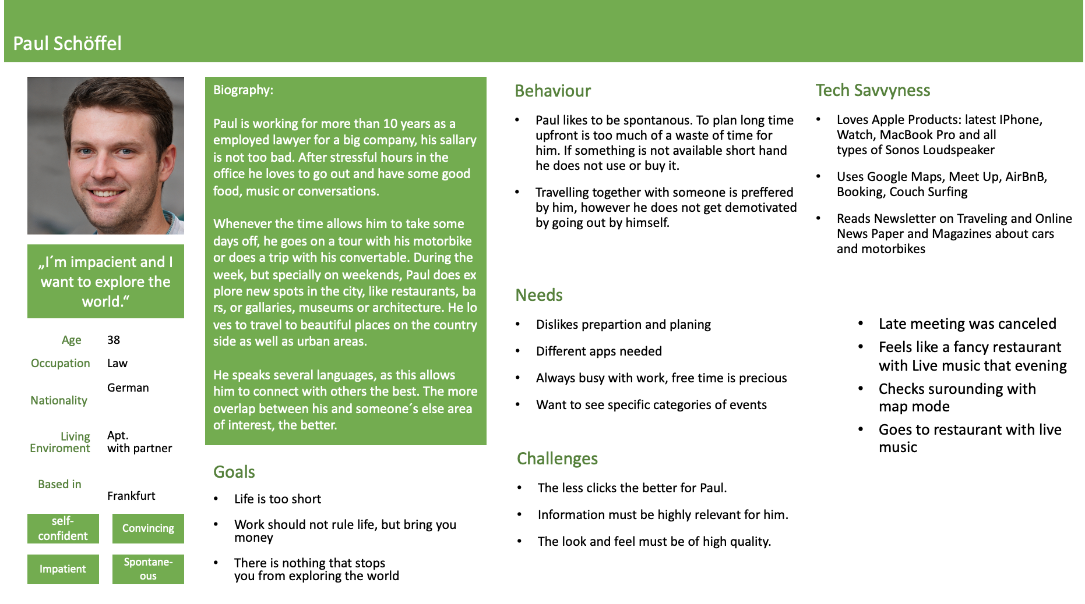
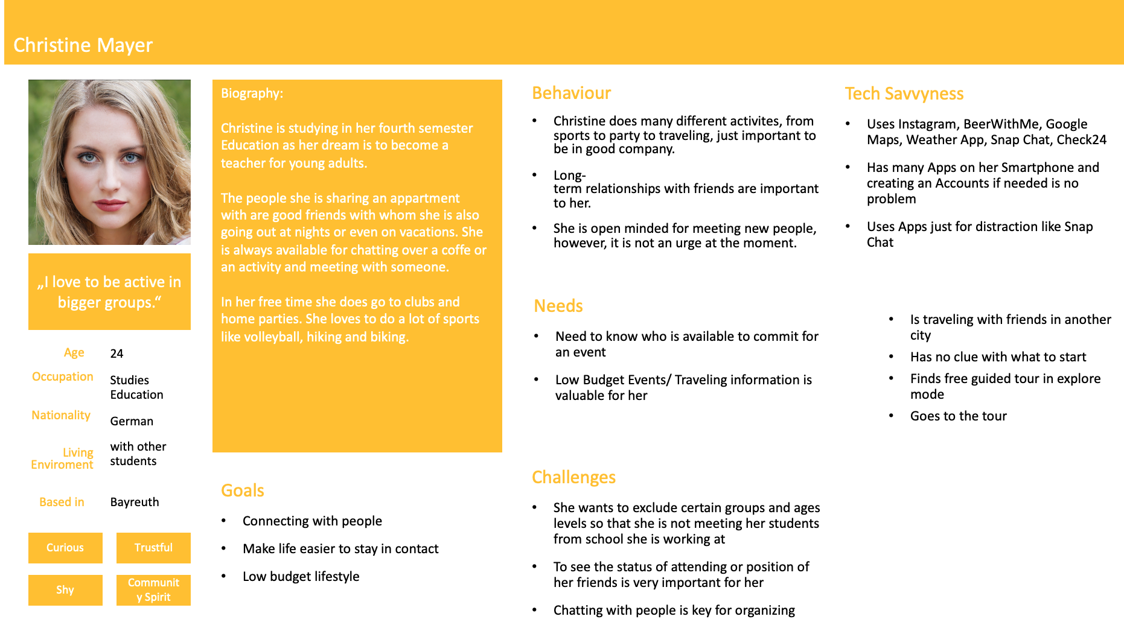
Lehrstuhl für Ergonomie TUM School of Engineering and Design Technical University of Munich
{ Personas …
Vincent Brunner | Beatrice Seibert | Stefano Ferrari| Interaction Prototyping| Winter Semester 2021/2022
1

Slide 6
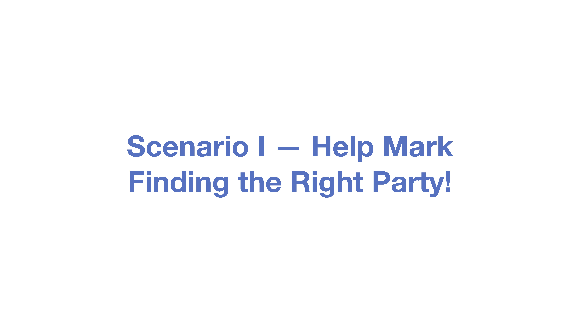
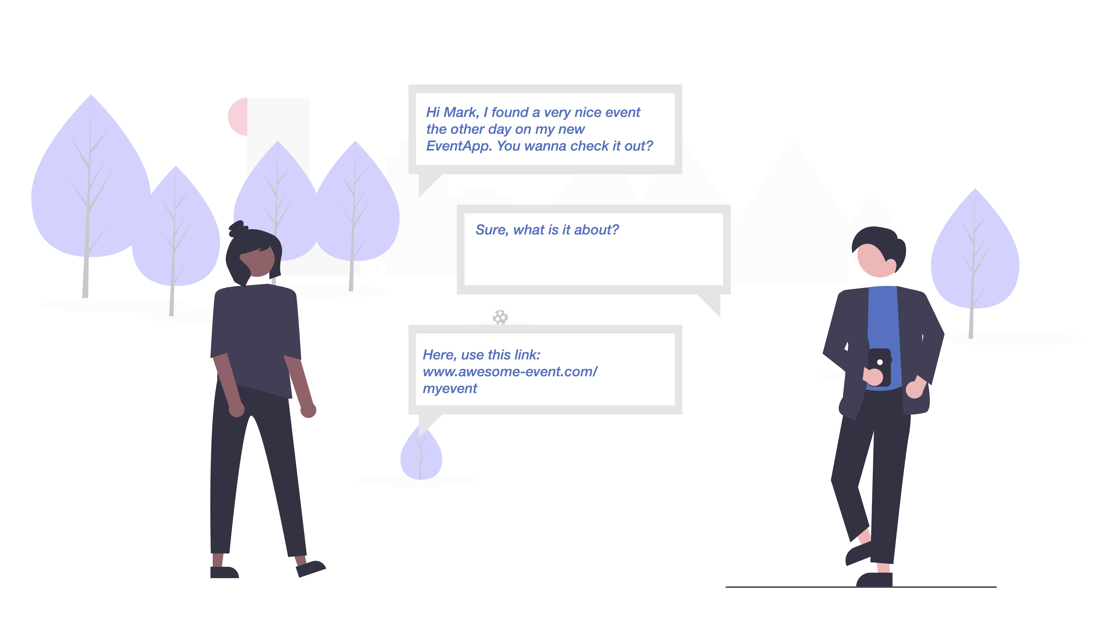
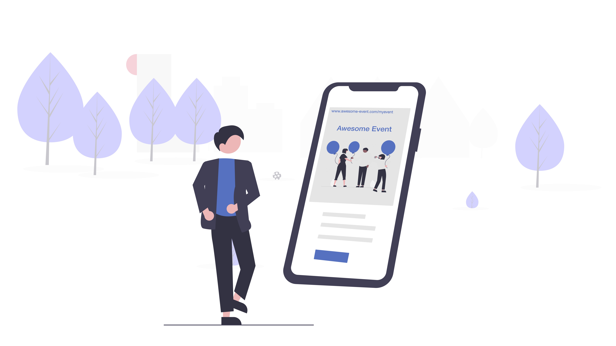
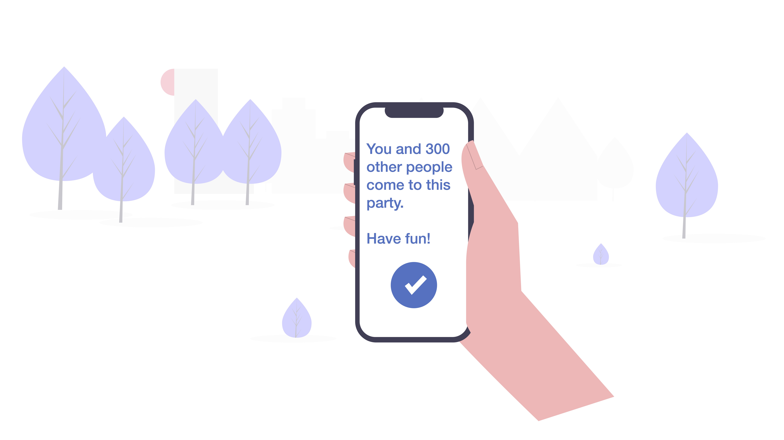

Lehrstuhl für Ergonomie TUM School of Engineering and Design Technical University of Munich
… Scenarios}
Vincent Brunner | Beatrice Seibert | Stefano Ferrari| Interaction Prototyping| Winter Semester 2021/2022
1

Slide 7
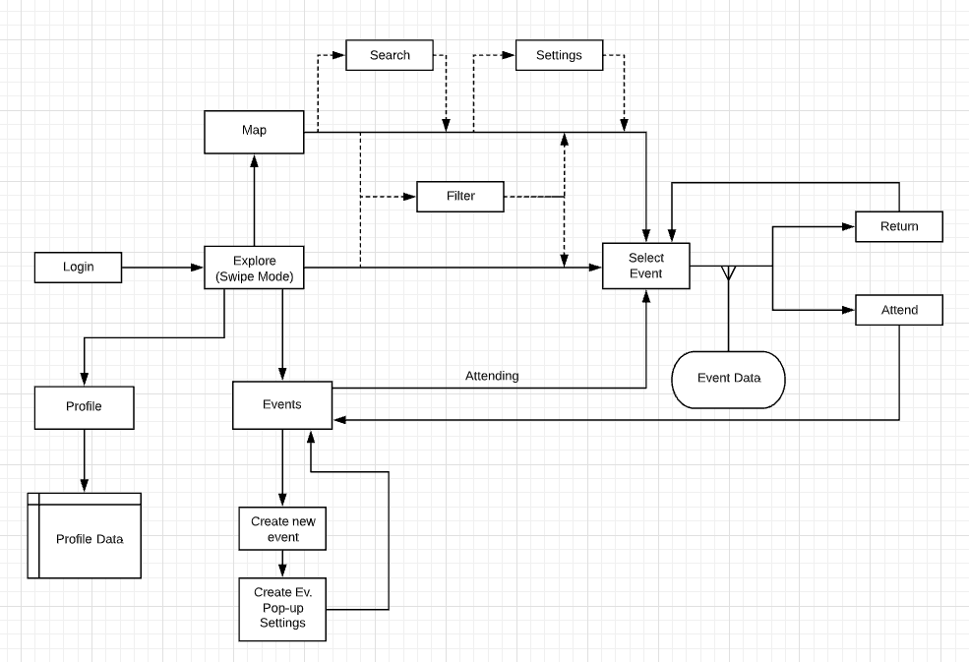
Lehrstuhl für Ergonomie TUM School of Engineering and Design Technical University of Munich
Use Flow & App Functionality
Vincent Brunner | Beatrice Seibert | Stefano Ferrari| Interaction Prototyping| Winter Semester 2021/2022
1

Slide 8
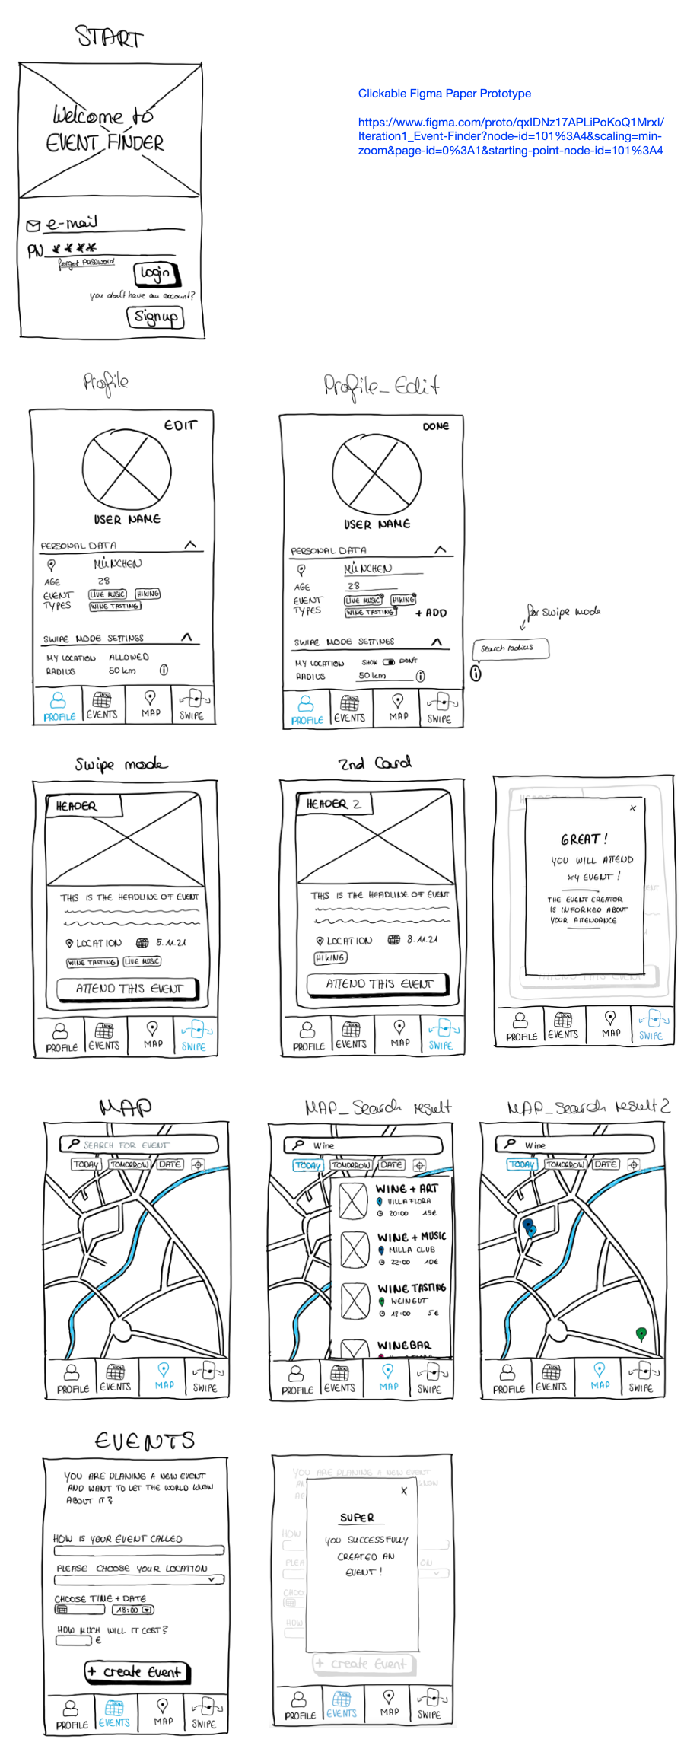
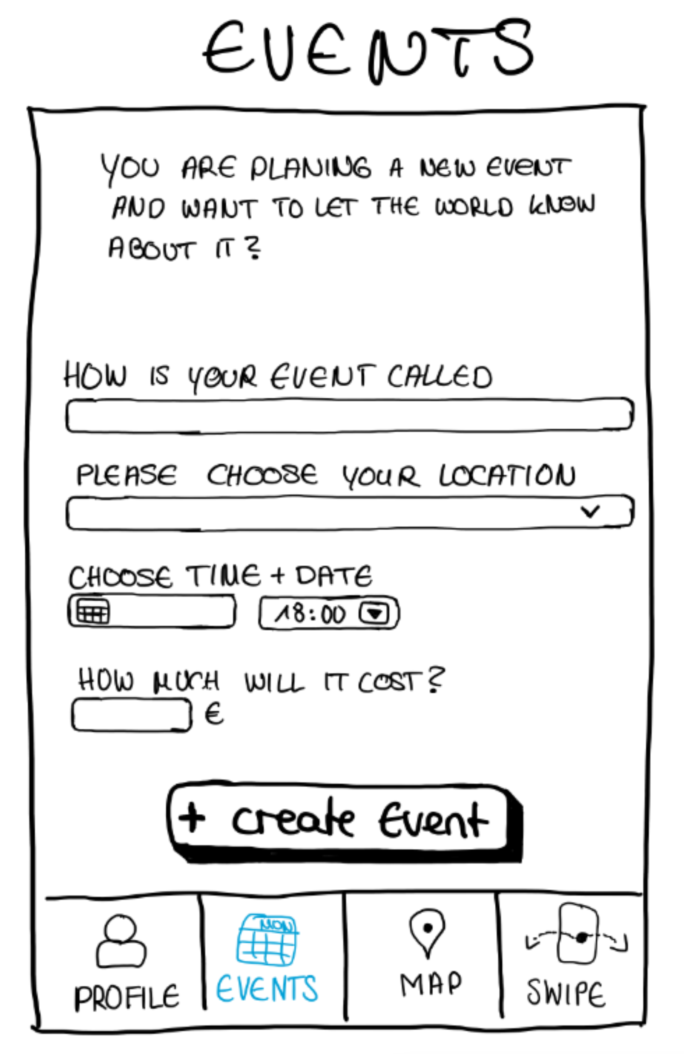
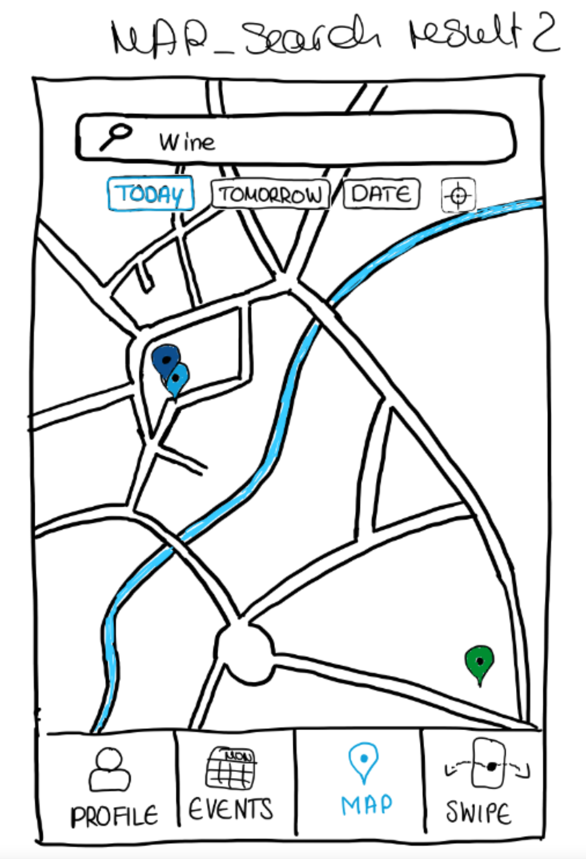
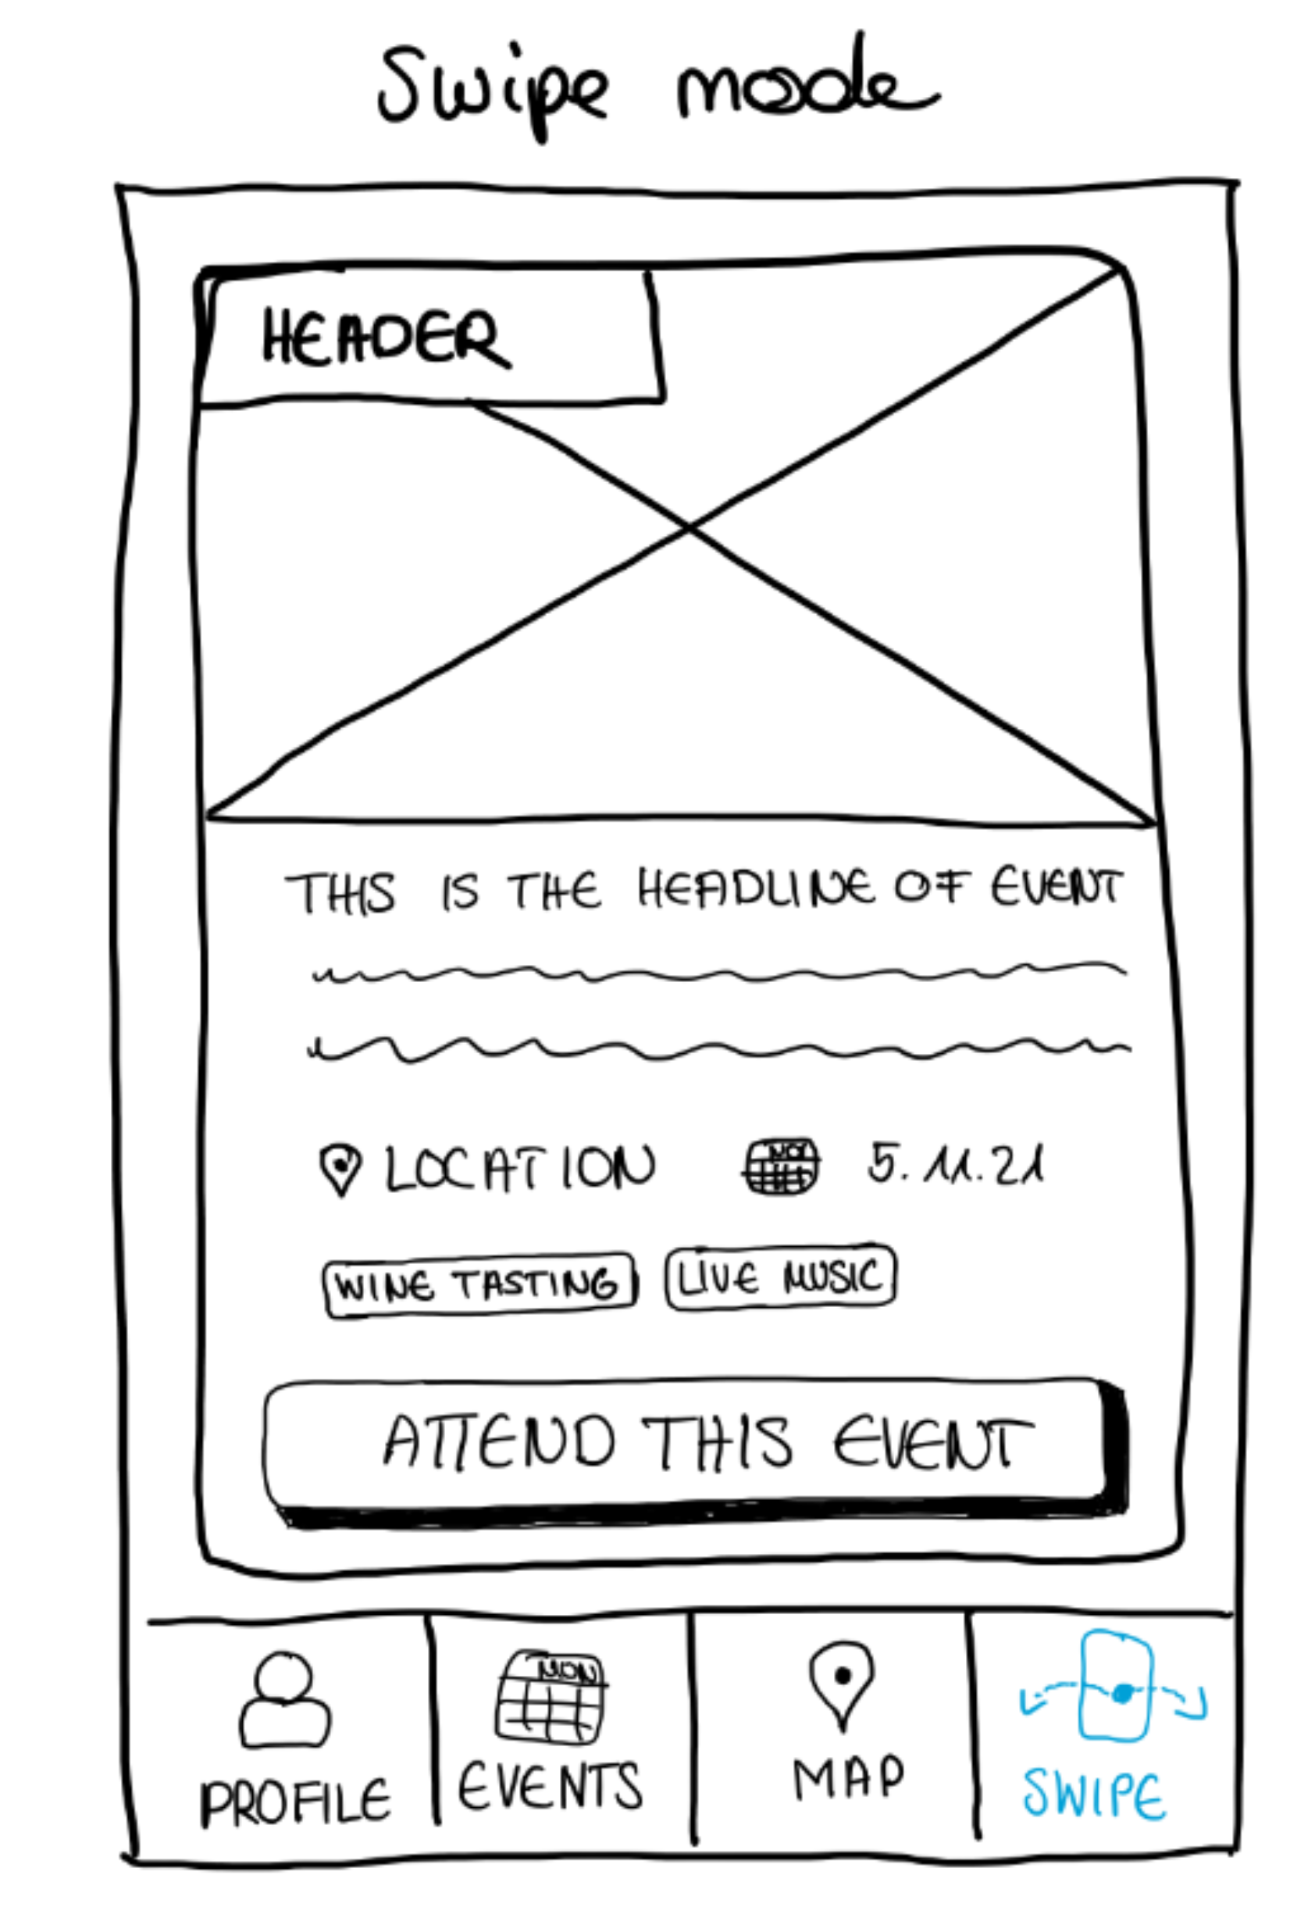
Lehrstuhl für Ergonomie TUM School of Engineering and Design Technical University of Munich
Paper Prototype
https://www.figma.com/proto/qxIDNz17APLiPoKoQ1MrxI/Iteration1_Event-Finder?node-id=101%3A4&scaling=min-zoom&page-id=0%3A1&starting-point-node-id=101%3A4
Vincent Brunner | Beatrice Seibert | Stefano Ferrari| Interaction Prototyping| Winter Semester 2021/2022
1

Slide 9
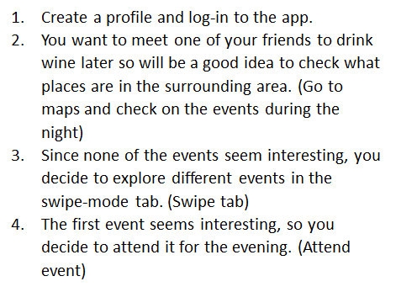
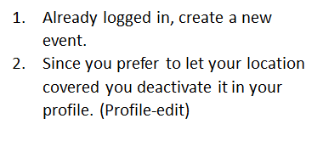
Lehrstuhl für Ergonomie TUM School of Engineering and Design Technical University of Munich
User Test Guideline – User Tasks
Vincent Brunner | Beatrice Seibert | Stefano Ferrari| Interaction Prototyping| Winter Semester 2021/2022
1

Slide 10
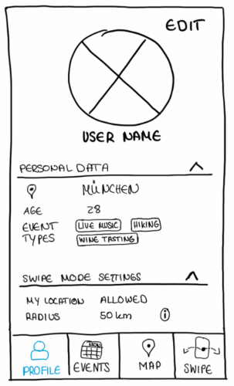
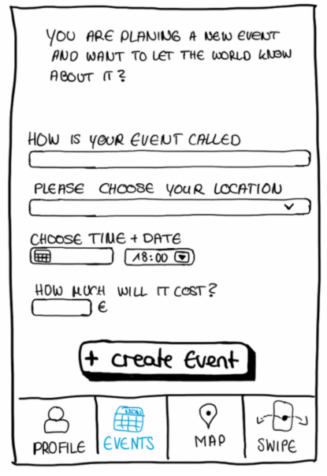
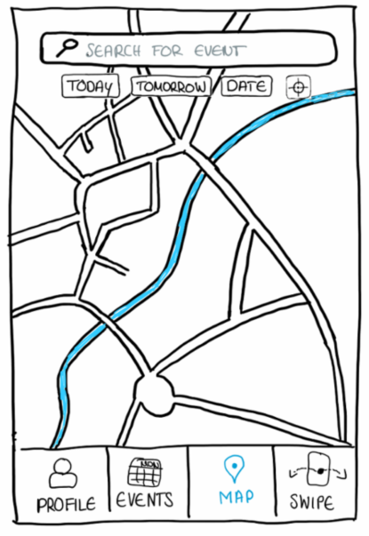
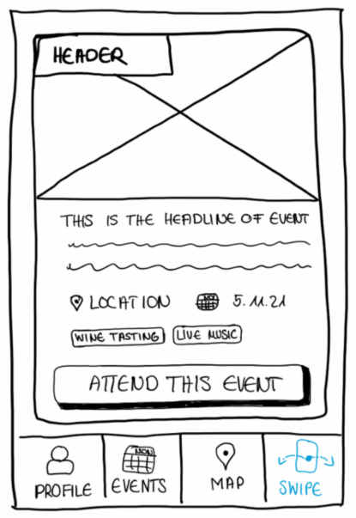
Lehrstuhl für Ergonomie TUM School of Engineering and Design Technical University of Munich
Usability Report – Findings and Takeaways
Profile
Events Tab
Attended events
Button size
Private vs. professional events
Moderation private events
General
Users are happy with available functions and exploring mode
Information Structure partly missleading
Map
Swipe Mode
Highlight Event
Today is default
Logic swipe direction
Meaning of "attend this event"
Vincent Brunner | Beatrice Seibert | Stefano Ferrari| Interaction Prototyping| Winter Semester 2021/2022
1

Slide 11
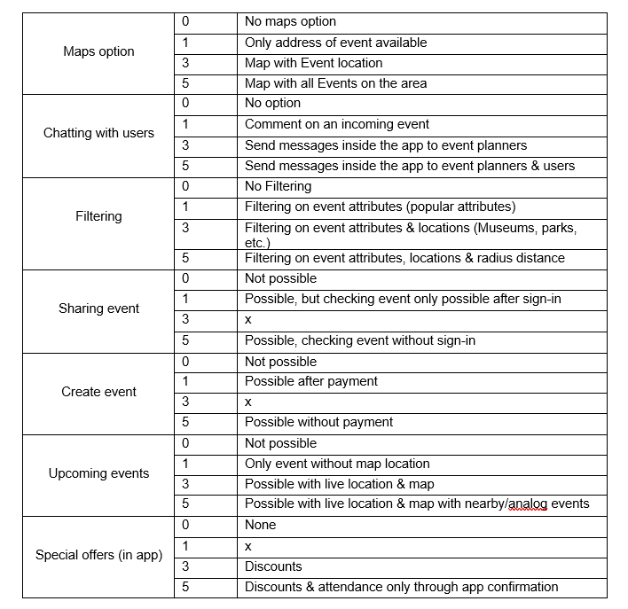
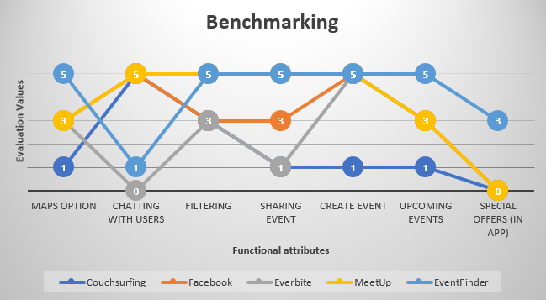
Lehrstuhl für Ergonomie TUM School of Engineering and Design Technical University of Munich
Benchmarking
Vincent Brunner | Beatrice Seibert | Stefano Ferrari| Interaction Prototyping| Winter Semester 2021/2022
1

Slide 12

Lehrstuhl für Ergonomie TUM School of Engineering and Design Technical University of Munich
Thank you for your attention!
… any questions?
Vincent Brunner | Beatrice Seibert | Stefano Ferrari| Interaction Prototyping| Winter Semester 2021/2022
1

